Slide 1
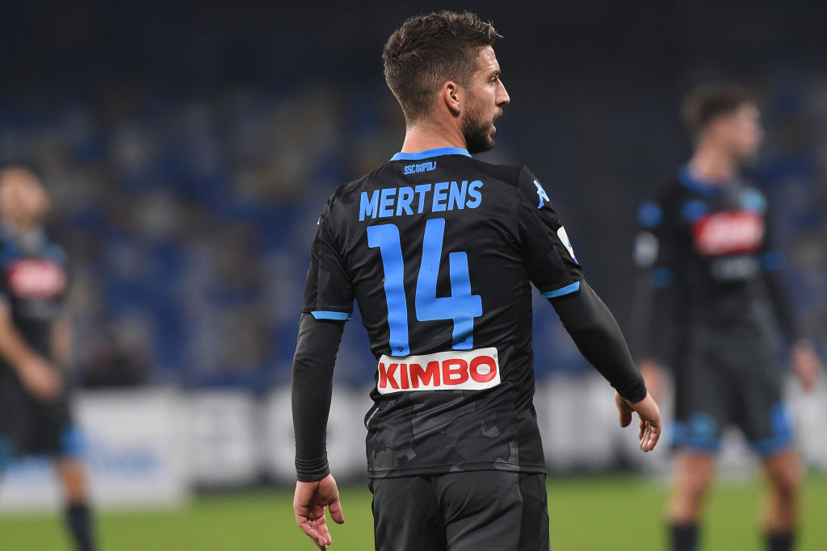
My First Pygame Project

Slide 2
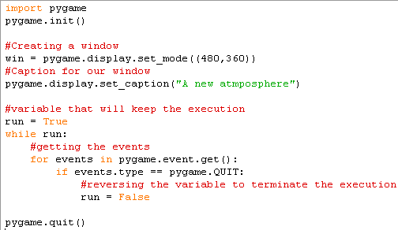
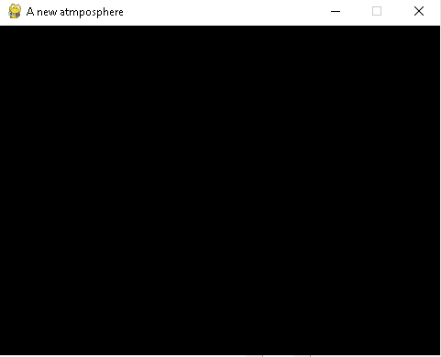
Pygame – The Beginnings
First we have to set up a screen followed by a caption for our game
First we have import the module pygame to our project
Then we have to initialize it.
Next step involves creating a window with a suitable width and a suitable height
We have to set a good caption for our game to attract people
Then we will create a variable which will facilitate the execution. As long as this variable stays true the window will remain in our screen.
This pygame as a whole will be driven by events which will act upon the user input.
The moment when we decide to close the window the QUIT event will get triggered which will set the variable to false.
The overall event quit will facilitate smooth termination

Slide 3

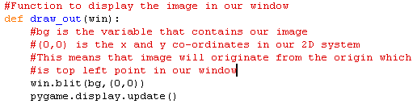
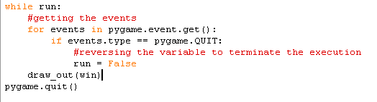
Pygame – Setting a background
Once we have created a window the next step involves fitting a background inside our window.
Once the image is assigned to a variable we have to display that image in our window.
This function will place our image in the window.
Pygame.display,update function will accommodate our changes in the window.
This function will be called inside the loop and our image will get displayed as long as this variable stays true.

Slide 4
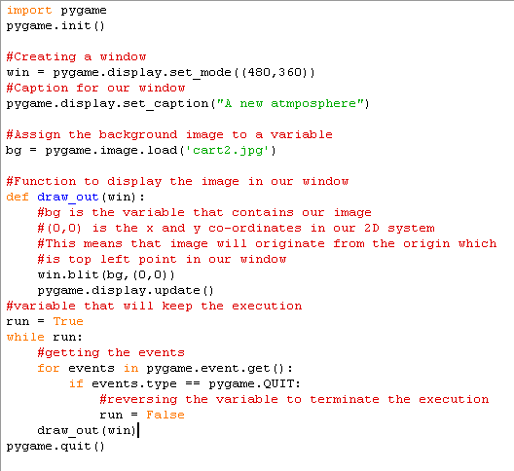
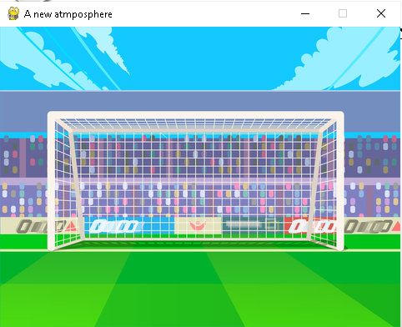
Pygame – Setting a background (Full Code + Output)

Slide 5
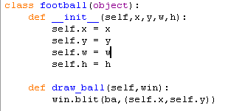
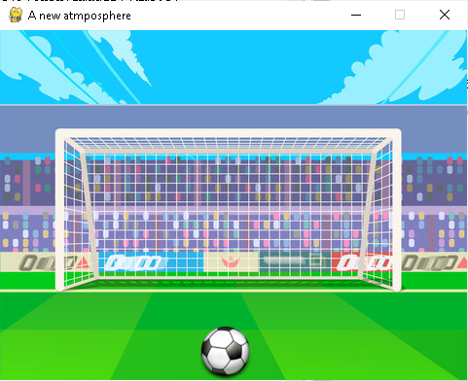

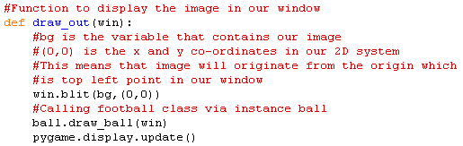
Pygame – Time to create the protagonist
Since our game literally involves football the namesake is going to be our hero.
Create a new class named football to assign properties for our hero.
Init is the constructor which will store all the variables in the self object which can be accessed anywhere inside the class football. X and y are positions in our co-ordinate system whereas w and h are width and height respectively.
The class will also contain a method named draw_ball which will place our hero in the window.

Slide 6
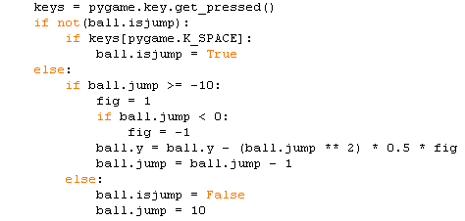
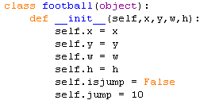
Pygame – The immovable object
Create a new variable which will consist all the user actions done to give input to our game.
We will configure SPACE as the input for jump.
Two more fields isjump and jump will be added to our class. Initially this isjump field will be set to False as the ball will be in a state of rest.
Once spacebar is hit, the isjump field will be active meaning that the ball will move upward up to a distance of 10(can be any number).
Since this process involves moving up and down which means it is kind of following quadratic equation. It starts with 10 and ends with -10.
Moving up will result in decrease of y co-ordinate values hence we are subtracting y value. Likewise while coming back down y co-ordinate value will increase. Hence, the variable fig is used which will be negative which will in turn add the y co-ordinate value.
Once the ball has returned back to it’s original state the isjump and jump variables will be restored back

Slide 7

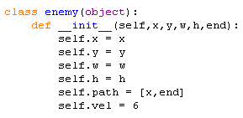
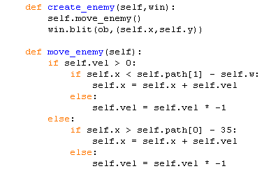
Pygame – The unstoppable force (The Antagonist)
First assign the image to a variable.
Then just like our hero create a new class for our villain. Since our villain is a moving object the property velocity will come with it in order to facilitate the speed at which our villain will move.
The method move_enemy will facilitate the movement of our enemy. Goring forward towards the right means that an increase in x co-ordinate hence the addition.
Once the object has reached its limit it has to move in the opposite direction meaning that the x co-ordinate has to be decreased hence velocity value has been reversed.
This process will repeat again.
Then we will have to place the image in our window.

Slide 8
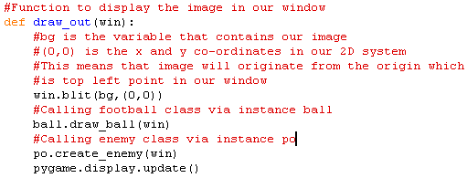
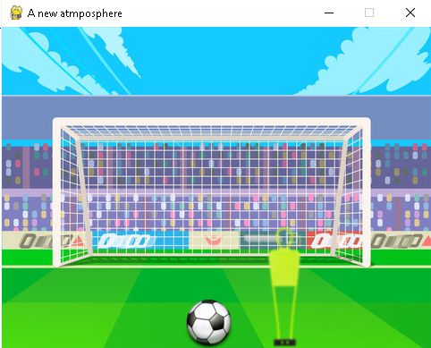
Pygame – The unstoppable force (The Antagonist) (Contd.)

Slide 9
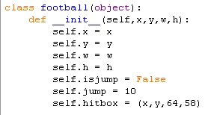

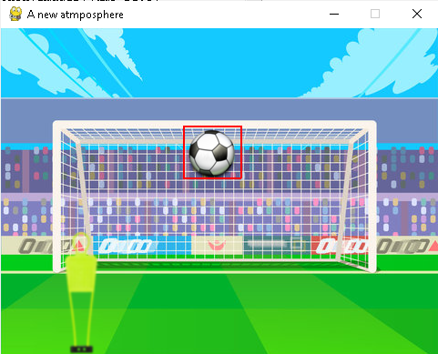
Pygame – Constructing the hit boxes
Creating hit boxes will facilitate collision between objects. They act as a boundary which encapsulates the object with it.
Any foreign object that comes in contact within this boundary will instigate a collision.
Constructing a hit box involves creating a rectangle covering our object.
A new property named hit box will be added to our football object. It has 4 elements namely x and y co-ordinates, width and height of our box.
Then while creating a object we will draw a rectangle around our object as shown which will move as and when the football moves.
In draw rect function the first field indicates the window, followed by the colour of our rect, the dimensions and thickness

Slide 10
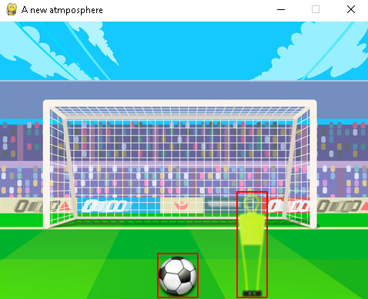
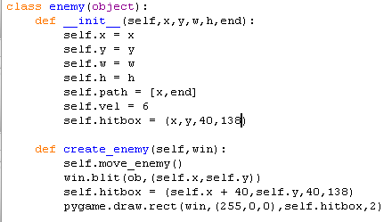
Pygame – Constructing the hit boxes (Contd.)
Now that the hit box has been constructed for our hero we need to repeat the same logic for our villain.

Slide 11
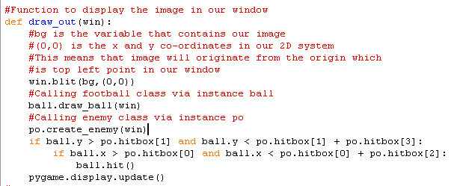

Pygame – Setting up the collision
In order to instigate a collision we have ensure that there is a overlap with respect to the co-ordinate values of the obstacle & football with respect to both x-axis and y-axis.
Collision with respect to y co-ordinate will happen within the range of y co-ordinate of the obstacle and y co-ordinate value at the ground(y co-ordinate of obstacle + plus height of obstacle).
Hence, the y co-ordinate of the football has to lie within this range to facilitate a collision.
With respect to x co-ordinate the x co-ordinate of football has to lie within the range of x co-ordinate of obstacle and x co-ordinate of the obstacle plus width of it.

Slide 12
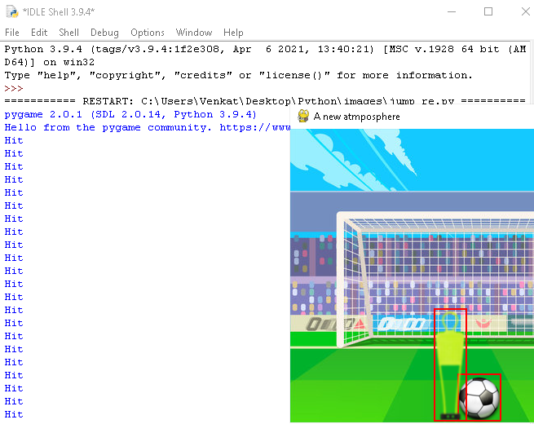
Pygame – Setting up the collision (Contd.)
As we can see from the image, every time the ball comes in contact with the obstacle i.e. the overlapping of co-ordinates we get to see the string hit being printed in the output console.

Slide 13
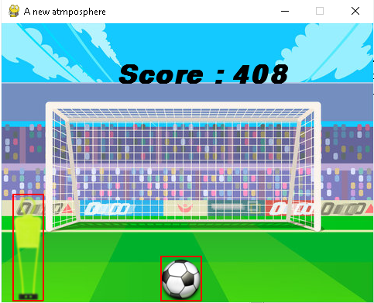
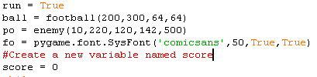
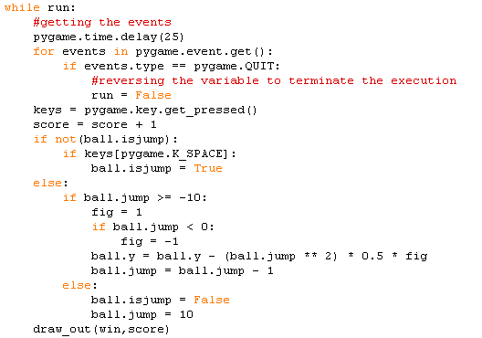

Pygame – Scoring all the way to glory
In order to make the game more interesting and attractive, we have to reward the football for evading the obstacle and keeping the obstacle at bay. For that we are going to create a new variable called which will keep on incrementing as long as the football escapes from the obstacle.

Slide 14




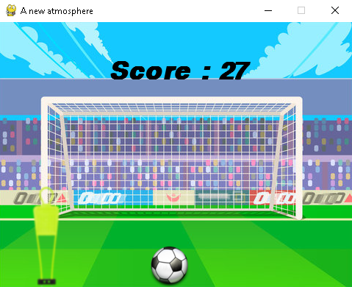
Pygame – Improvising
Score gets incremented way too fast which needs to be adjusted.
Likewise, now that the collision has been settled we can remove the rectangles which were set for illustration.
Now even though the time will get updated in a flash the score will be updated only when the value of time gets incremented to a value which is divisible by 5.
Removing the collision boxes involves commenting the draw rect lines.
Further more improvisation involves stopping the game when the collision happens.

Slide 15

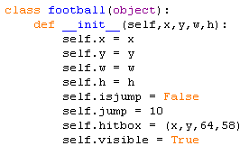

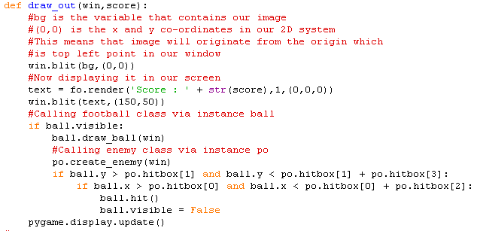
Pygame – Improvising (Contd.)
To add a background music to our game, we can utilize the following piece of code to include it.
Next we have to stop the game once the collision. In our case stopping the game implies stopping the scoring rate once the collision occurs.
We are going to add a new property named visible which is a flag field that will be active as long as the collision doesn’t happen.
As we can see from the code snippet the visible field will be set to false once the collision happens meaning that neither the ball nor obstacle will be displayed in the screen.

Slide 16

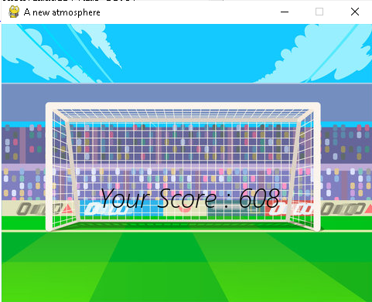




Pygame – Improvising (Contd.)
Once the ball collide with the obstacle the scoring stops and we get a summary stating our final score.
Now we need to add sound effects whenever we kick the ball and when the ball collides with the obstacle.

